Slide 1

WELCOME
We are waiting a few minutes for more individuals to join. We will start promptly at 13:10.
South Africa Works because of Public Works

Slide 2
Annual Financial Statements Inputs 2022/2023
South Africa Works because of Public Works

Slide 3
AGENDA
Activity | Branch/Unit
Welcome | All
Housekeeping and Welcome | All
Background and Context | All
Link to audit disclaimer | All
Cleaning, Gardening & Security | Finance /SCM/FM
Other Accruals | Finance/Logistics
Movable Assets | Movable Assets/Finance
Finance Leases (Cell phones, 3G, copier machine) | Movable Assets/ Finance/Provisioning and Logistics
General Guidelines | All
Closure | All

Slide 4

Housekeeping and Welcome

Slide 5




HOUSEKEEPING
Feel free to ask questions or make comments in the chat, Kamogelo will note them and we will go through them individually at the end of every training section
Please mute yourself unless you are acknowledged and requested to speak
If you would like to be acknowledged to raise a question or provide a comment, please raise your hand
Please turn your video off

Slide 6

1. BACKGROUND & CONTEXT

Slide 7
BACKGROUND AND CONTEXT
AFS provide information about the results of operations, financial position, and cash flows of an organisation.
PMTE received a disclaimer of audit opinion from AGSA for 2021/2022 AFS audit.
To clear the disclaimer - requires inputs and assistance from all units.
Line Functions and regions to provide additional inputs, via workbooks, to properly account for full effect of all transactions as per GRAP (Generally Recognised Accounting Practice)
Accrual accounting knowledge is critical for clean and unqualified audit

Slide 8

3. DISCLAIMED OPINION
- MEANING AND IMPLICATIONS

Slide 9
DISCLAIMED AUDIT OPINION

Slide 10
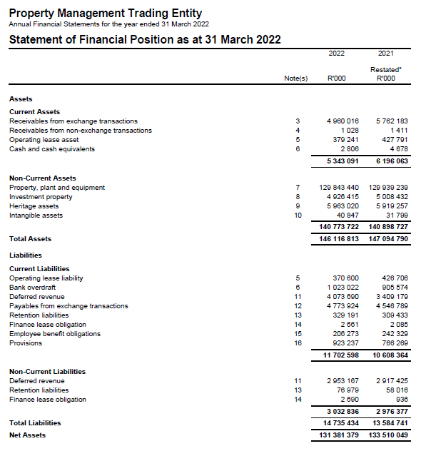

DISCLAIMED AUDIT OPINION
Assets
Liabilities
Equity

Slide 11

DISCLAIMED AUDIT OPINION
Disclaimer of audit report paragraphs in 2021/2022 AFS
Payables from exchange transactions - Accrued expenses- Municipal services
Difference between recalculated amount by auditors and accrued amount in the workbook (Accuracy issue)
Payables from exchange transactions - Accrued expenses
Goods and services were received before year end, however the trading entity did not recognize the accrued expenses (Completeness issue)
PPE
Restatement could not be substantiated by supporting audit evidence (Limitation of scope)
Payables from exchange transactions - Accrued expenses- Leases
Difference between the recalculated balance and the accrued expenses (Completeness issue)

Slide 12

2. CLEANING, GARDENING AND SECURITY

Slide 13
2.1 APPROACH TO ACCRUING FOR CLEANING, GARDENING AND SECURITY ACCRUALS
Not all payments for cleaning, gardening and security are made as and when the services are received.
Therefore, at any given date, we have received services relating to these expenses without paying for them to date. This creates an accrual for which we should calculate the total value.
Two reports should therefore be supplied to indicate the values for these expenses:
Report for CLEANING and GARDENING accruals
Report for SECURITY accruals
The format for these reports are exactly the same, but for reporting purposes we need them to be split accordingly.

Slide 14
2.2 APPROACH TO RECORD CLEANING, GARDENING AND SECURITY ACCRUALS
Refer to
Cleaning and Gardening
Workbook

Slide 15





3. OTHER ACCRUALS

Slide 16
3.1 APPROACH TO ACCRUING FOR OTHER ACCRUALS
Payments for various other services are not made as and when the services are received.
Therefore, at any given date, we have received services relating to a number of expenses (Cellphone, Travel, Printing, etc.) without paying for them to date. This creates an accrual for which we should calculate the total value.
All these expenses which have not been covered in one of the other accrual reports should then be reflected on the Other Accruals report, including accruals from the following systems:
SAGE
LOGIS
PERSAL
Other

Slide 17
2.2 APPROACH TO RECORD OTHER ACCRUALS
Refer to
Other Accruals
Workbook

Slide 18

4. MOVABLE ASSETS

Slide 19
4.1 MOVABLE ASSETS – BACKGROUND & PURPOSE
To set out the operational and financial reporting impact for Movable Assets.
PMTE Finance relies on information and data submitted by Movable assets unit in order to prepare the disclosure of the PPE for the financial statements

Slide 20
4.1 MOVABLE ASSETS – Challenge - Inaccurate & Missing conditional Assessments
Conditional assessments rating should consists of 5 options:
Very poor
Poor
Fair
Good
Excellent
Movable Asset and Finance directorate have updated a Movable Asset policy to be alignment with Immovable asset policy in terms of 5 level of conditions status.

Slide 21
4.1 MOVABLE ASSETS – Challenges - Other
Other concerns:
Asset register submitted to Finance with duplicates
Monthly reconciliations do be done at regions and Head office
Unauthorised transfer of assets between DPW & PMTE
Late submission of LOGIS movable asset register.
All LOGIS registers and reports to be submitted to Head office Movable asset by 11th of following month unless otherwise communicated

Slide 22



5. FINANCE LEASES

Slide 23
5.1 FINANCE LEASES
Finance Leases
What is a finance lease?
A finance lease is a lease that transfers substantially all the risks and rewards incidental to ownership of an asset. Title may or may not eventually be transferred.
Notes:
The finance lease template relates specifically to cell phones, 3G, and office machines (photocopiers).
The templates used are templates that the regions have used in the past. Head Office requires however that due care is taken in filling the template particularly for start and end date as well as fair value of the asset since the accounting for these items will be based on amortization tables which are driven by these inputs. In addition, since the regions provide this report for both DPW and PMTE in one report, regions should ensure that they classify the appropriate responsible unit/directorate in order for the split between DPW and PMTE to be correct.
The templates are fairly similar for 3G, cell phones, and photo copier machines. Refer to the slides that follow in this regard.

Slide 24
5.1 FINANCE LEASES
Finance Leases
Finance lease indicators
The lease transfers ownership of the asset to the lessee by the end of the lease term.
The lease term is for the major part of the economic life of the asset, even if title is not transferred
The lessee has the option to purchase the asset at a price which is expected to be sufficiently lower than fair value at the date the option becomes exercisable that, at the inception of the lease, it is reasonably certain that the option will be exercised
Notes:
The finance lease template relates specifically to cell phones, 3G, and office machines (photocopiers).
The templates used are templates that the regions have used in the past. Head Office requires however that due care is taken in filling the template particularly for start and end date as well as fair value of the asset since the accounting for these items will be based on amortization tables which are driven by these inputs. In addition, since the regions provide this report for both DPW and PMTE in one report, regions should ensure that they classify the appropriate responsible unit/directorate in order for the split between DPW and PMTE to be correct.
The templates are fairly similar for 3G, cell phones, and photo copier machines. Refer to the slides that follow in this regard.

Slide 25
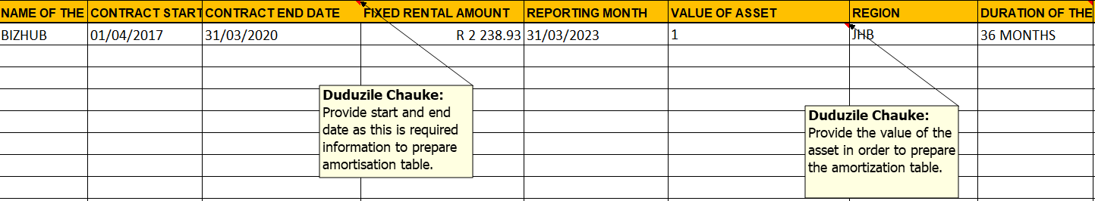
5.1 FINANCE LEASES

Slide 26
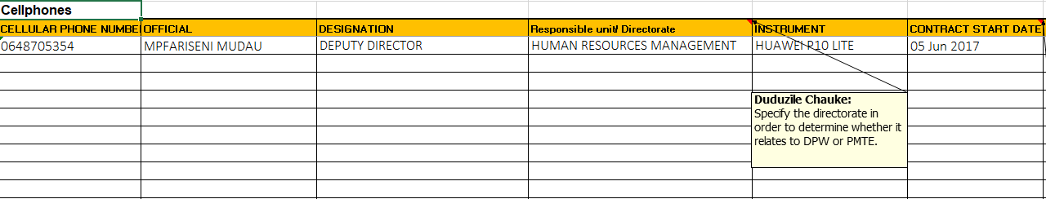
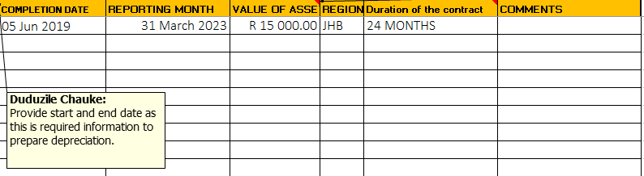
5.1 FINANCE LEASES

Slide 27

5. General Guidelines

Slide 28
5.1 GENERAL GUIDELINES – WORKBOOK FINALISATION
GENERAL GUIDELINES – WORKBOOKS
Review workbooks before submission to Head Office
Ensure that columns requiring dates are filled in date format
Ensure amounts are entered in numeric format
Review high values in the workbooks for existence
Follow up on all incomplete line items
Ensure all accruals listed relate to the period ending before 31 March 2023
No Blank cells in workbooks; if not applicable type “N/A” or “R0.00”
All relevant line items to be supported by documentation and referenced for ease of use in the audit file to be kept at every region, reference numbers to be indicated on the relevant workbooks
No workbooks will be accepted by Head Office if the Review Declaration is not completed and signed off and submitted with the relevant workbooks.
Liability
where we are CERTAIN OF
Timing AND Amount

Slide 29
5.2 GENERAL GUIDELINES – WORKBOOK STRATEGY
GENERAL GUIDELINES – DEADLINES
Issues relating to the quality of review of workbooks submitted
No review by finance of inputs prepared by line function due to the non-adherence to deadline dates
Numerous errors and follow ups required on workbooks
Date format and dates after reporting period
Duplicate entries
Incomplete information
Issues relating to adherence to deadline dates
Late submission of workbooks impacts consolidation and financial statements
Submission to AG required within 3 days of RFI or COFF
Liability
where we are CERTAIN OF
Timing AND Amount
CRITICAL:
Arrange adequate staff to compile and review workbooks within deadline dates

Slide 30
5.3 GENERAL GUIDELINES – WORKBOOK FEEDBACK
GENERAL GUIDELINES – AUDIT OPINION
Problem 1: Incompleteness
Solution: Capture all transactions that meet the criteria
Problem 2: Inaccuracy
Solution: Ensure that what is captured agrees to the supporting documents (Rand values and classifications)
Problem 3: Lack of supporting documentation for amounts captured
Solution: Ensure that supporting documents are available timeously for all amounts captured
Problem 4: Overstatement
Solution: Ensure that only transactions that meet the criteria are included in the workbook.
Do write-off submissions for all suspense account transactions that are not recoverable
Liability
where we are CERTAIN OF
Timing AND Amount

Slide 31

5. QUESTIONS

Slide 32
THANK YOU
South Africa Works because of Public Works

